Slide 1
Tutorial: Non-rigid mapping for spatially-dense phenotyping and mutlivariate statistical analysis

Slide 2
Part One: What is non-rigid mapping and what is it for?

Slide 3
Meshmonk
Purpose: Non-rigid mapping for spatially-dense phenotyping.

Slide 4
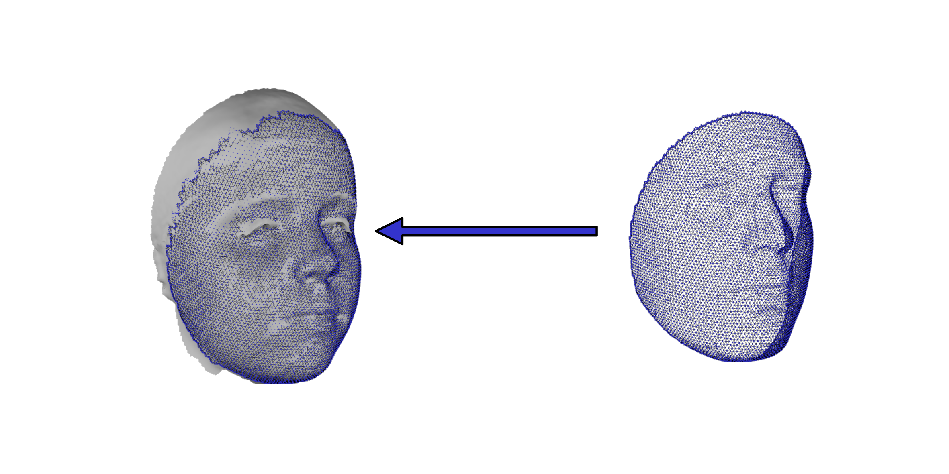
Meshmonk
Purpose: Non-rigid mapping for spatially-dense phenotyping.
Learn non-rigid mapping of a template ‘Floating’ shape into the shape of a ‘Target’ image while preserving the anatomical meaning of points.

Slide 5
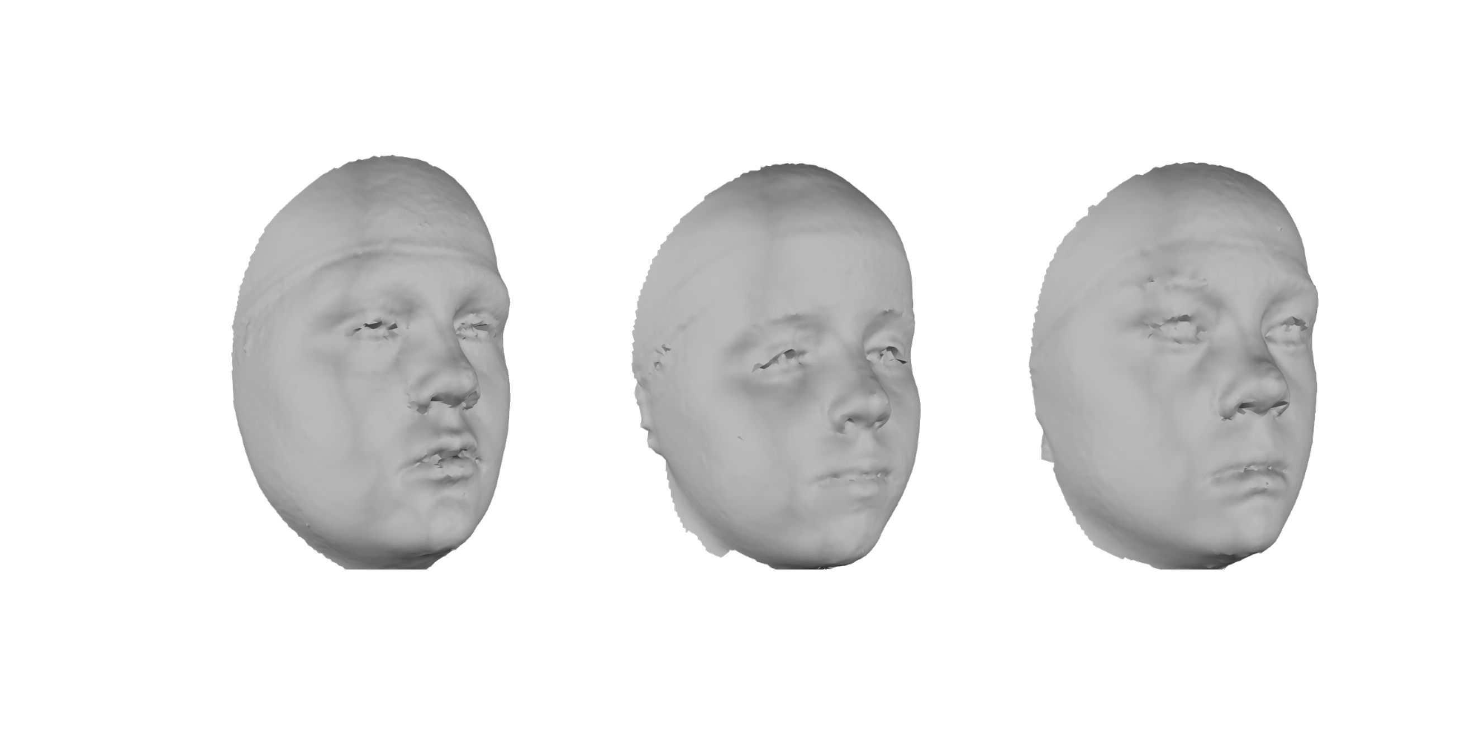
Spatially-dense phenotyping

Slide 6
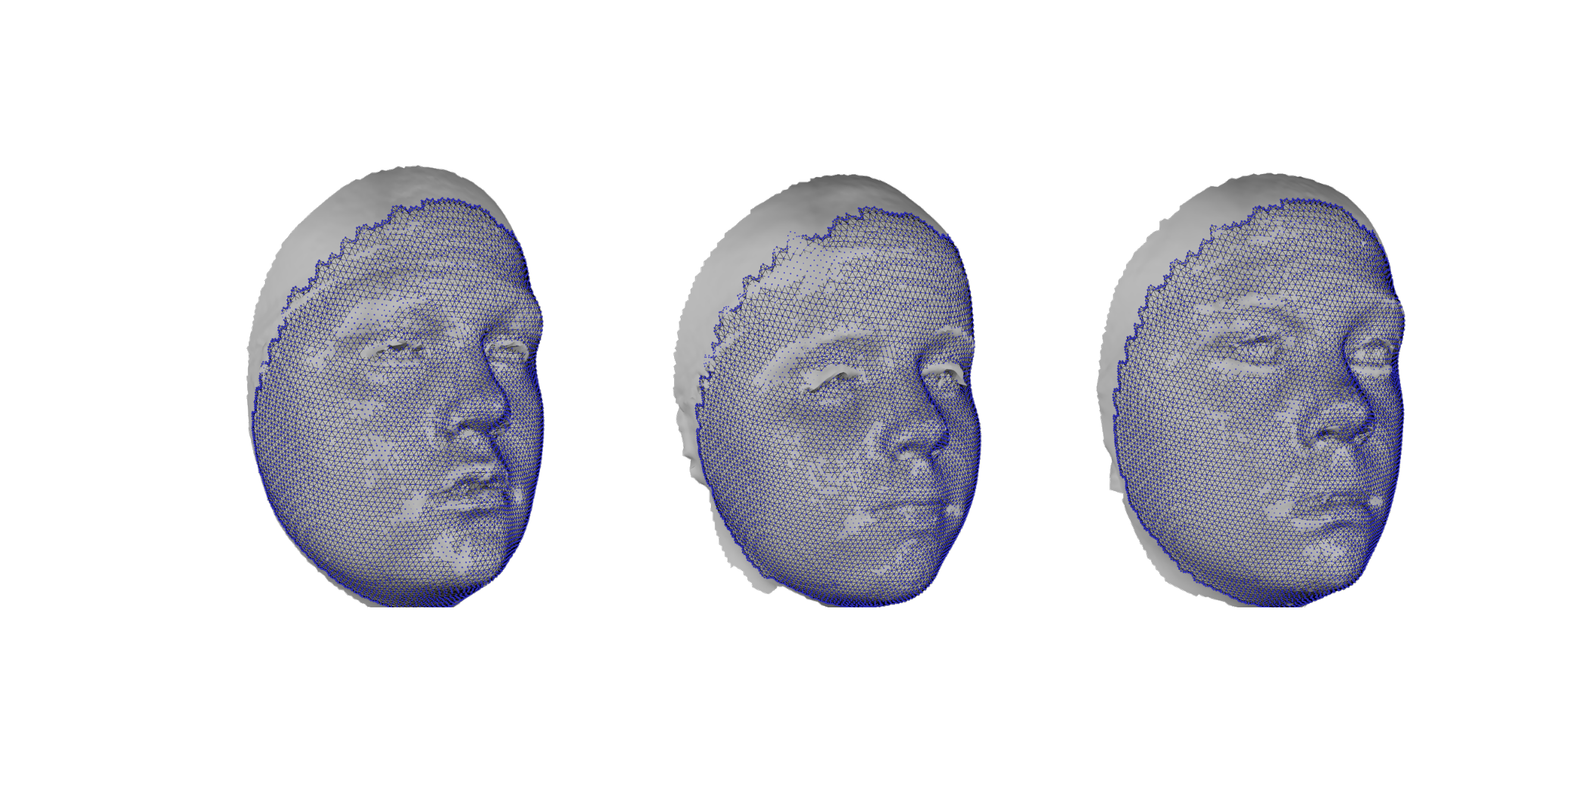
Spatially-dense phenotyping

Slide 7
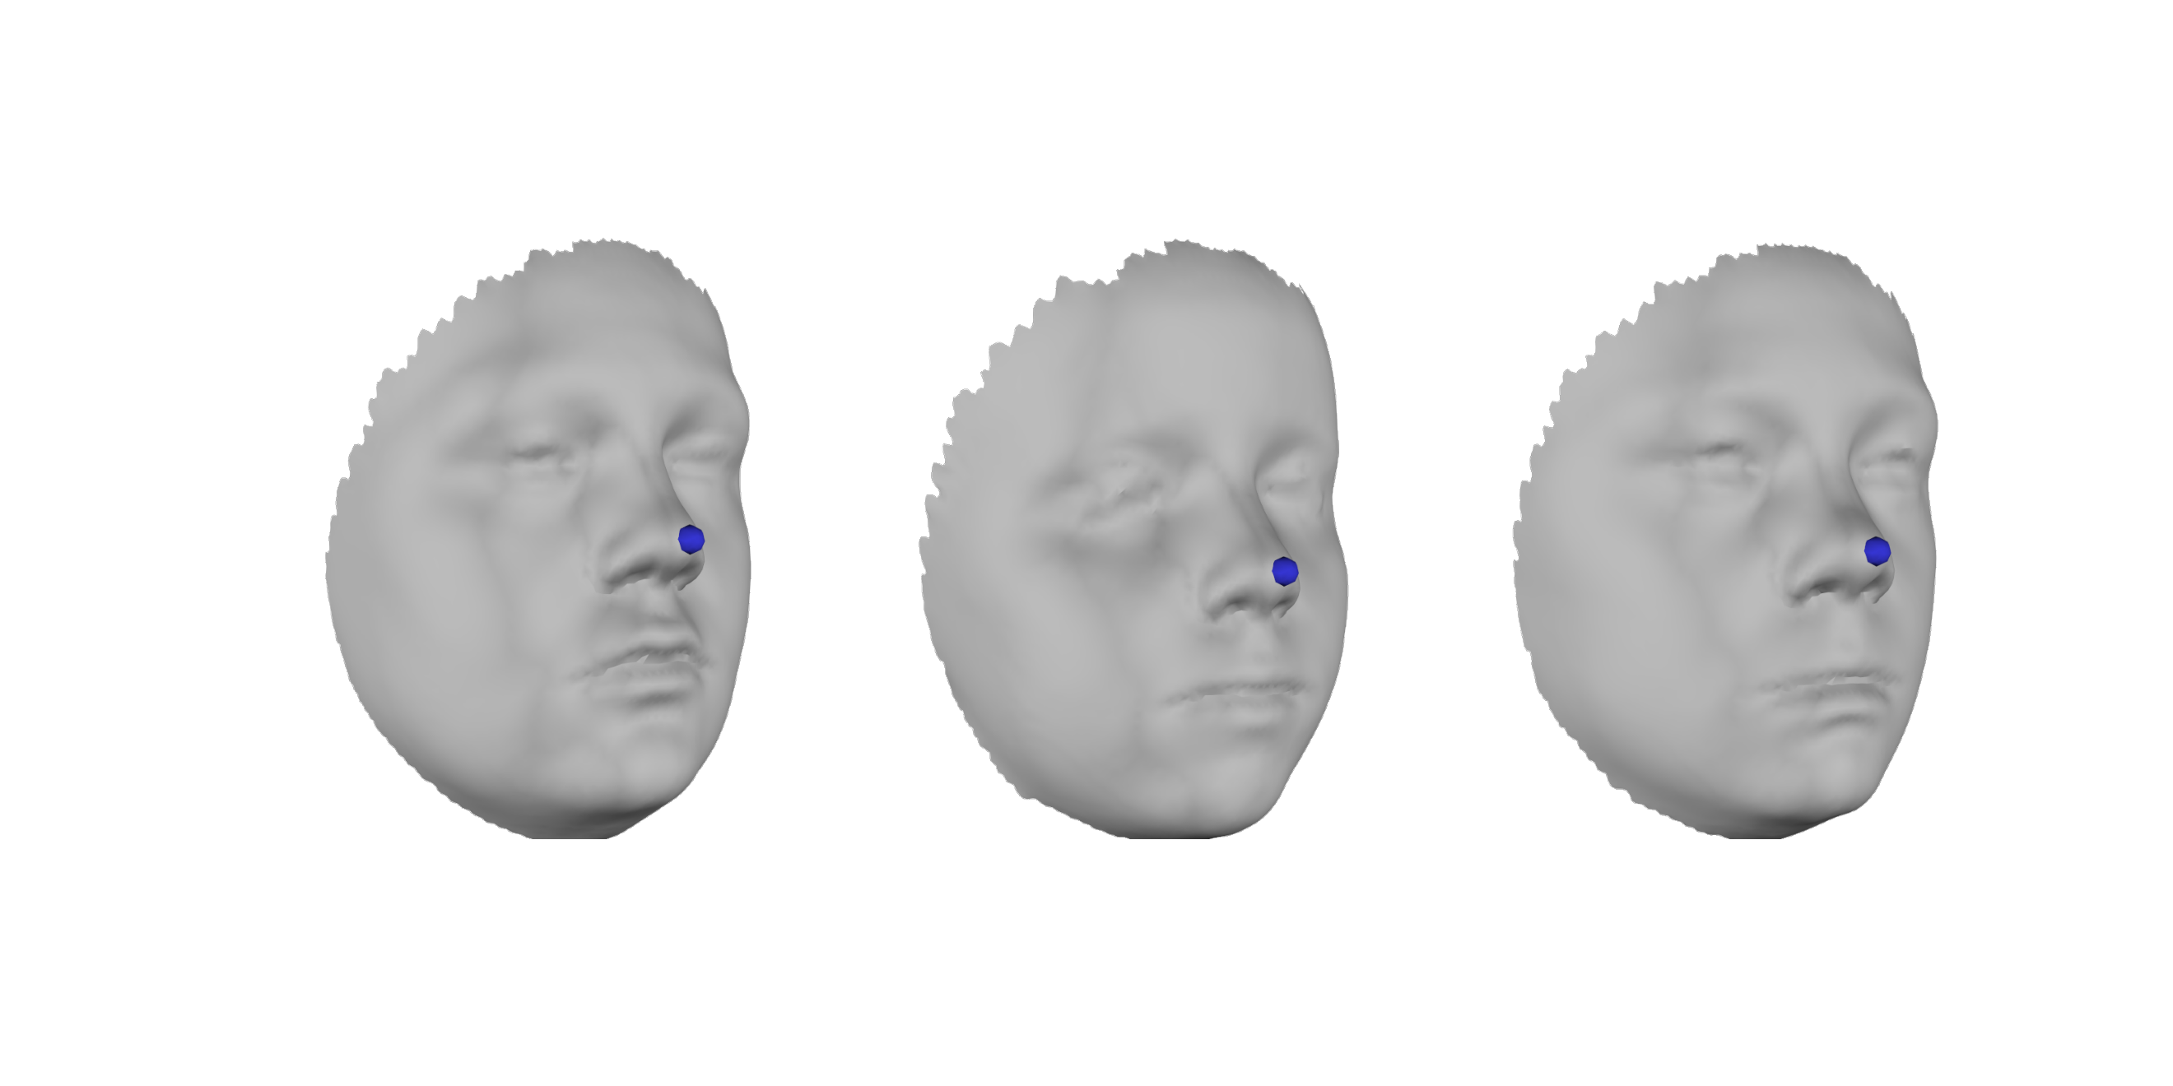
Preserving anatomical meaning of points
Vertex 4042

Slide 8
Meshmonk
Purpose: Non-rigid mapping for spatially-dense phenotyping.
Learn non-rigid mapping of a template ‘Floating’ shape into the shape of a ‘Target’ image while preserving the anatomical meaning of points.
Essentially resampling each Target
At 1000s of points. Because these
points correspond across the sample
they can be meaningfully combined
in multivariate statistical analyses.

Slide 9
Meshmonk Pipeline
Rigid initialization based on landmarks
Rigid ICP
Non-parametric, non-rigid ICP

Slide 10
Meshmonk Pipeline
Rigid initialization based on landmarks
First two steps rigidly align the floating face to the target, to provide a good starting point to the third step.
Rigid ICP
Non-parametric, non-rigid ICP

Slide 11
Meshmonk Pipeline
Rigid initialization based on landmarks
Third step is the important bit.
Rigid ICP
Non-parametric, non-rigid ICP

Slide 12
Part Two: Tutorial – Understanding non-rigid mapping with MeshMonk

Slide 13
Practicalities
Have MATLAB and Meshmonk installed.
Meshmonk installation instructions: https://github.com/TheWebMonks/meshmonk
Have Meshmonk ‘matlab’ folder on your machine.
Otherwise you will need to pair up with someone who has it installed.
Open ‘UnderstandingNonRigidMappingWithMeshmonk.m’

Slide 14
Practicalities
At the start of the script change ’tutorialPath’ to wherever the tutorial folder is on your machine.
Change the path in the line ‘addpath(genpath(path)) to wherever meshmonk/matlab is on your machine.
Run the first cell: ‘run section’ in the ‘Editor’ tab

Slide 15
Some helper classes
MATLAB classes (not core Meshmonk functions)
Shape 3D – represents a surface as a ‘mesh’
Viewer – supports viewing shape3D.

Slide 16
Exercise one: Visualise components of a mesh
Run the cells:
load an .obj wavefront as a Shape3D
visualise vertices using Viewer
Visualise the triangulated surface
Visualise the smooth surface

Slide 17
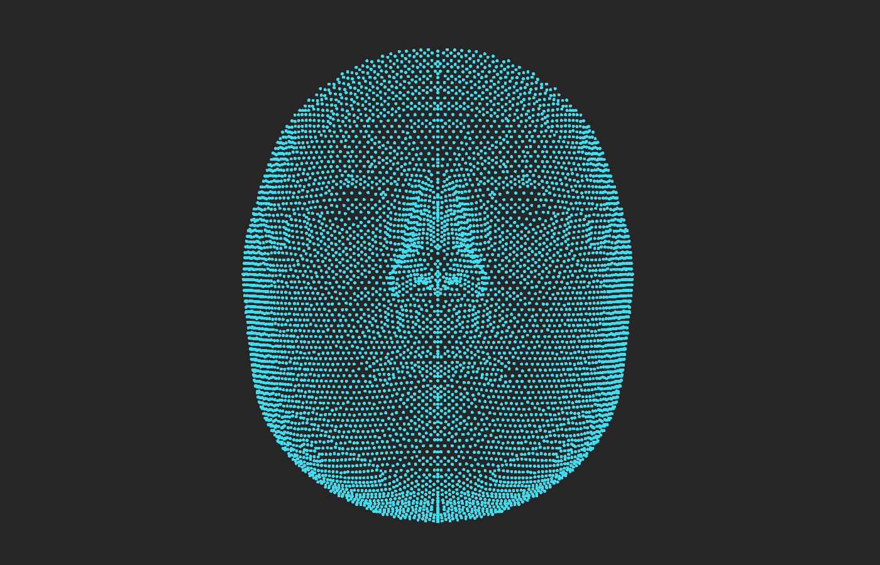
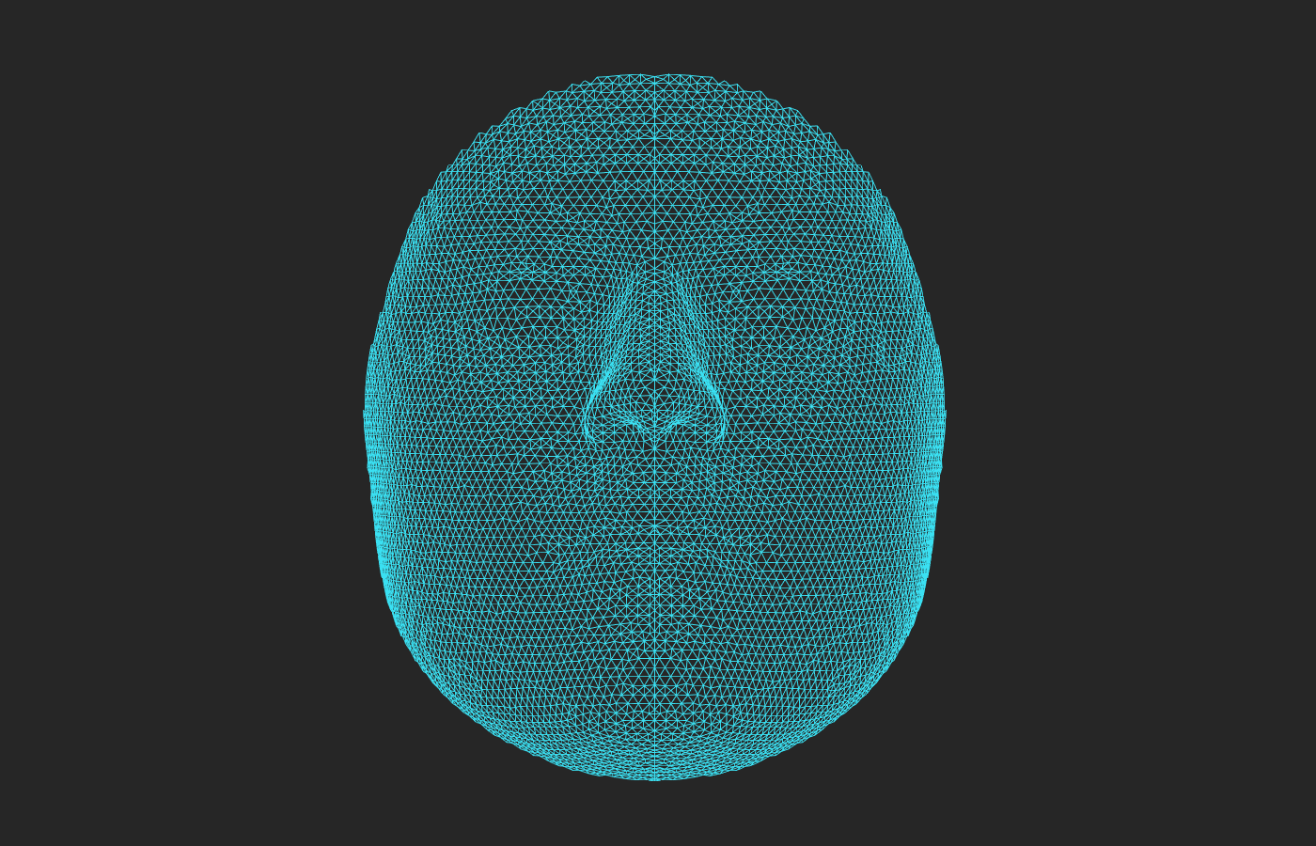
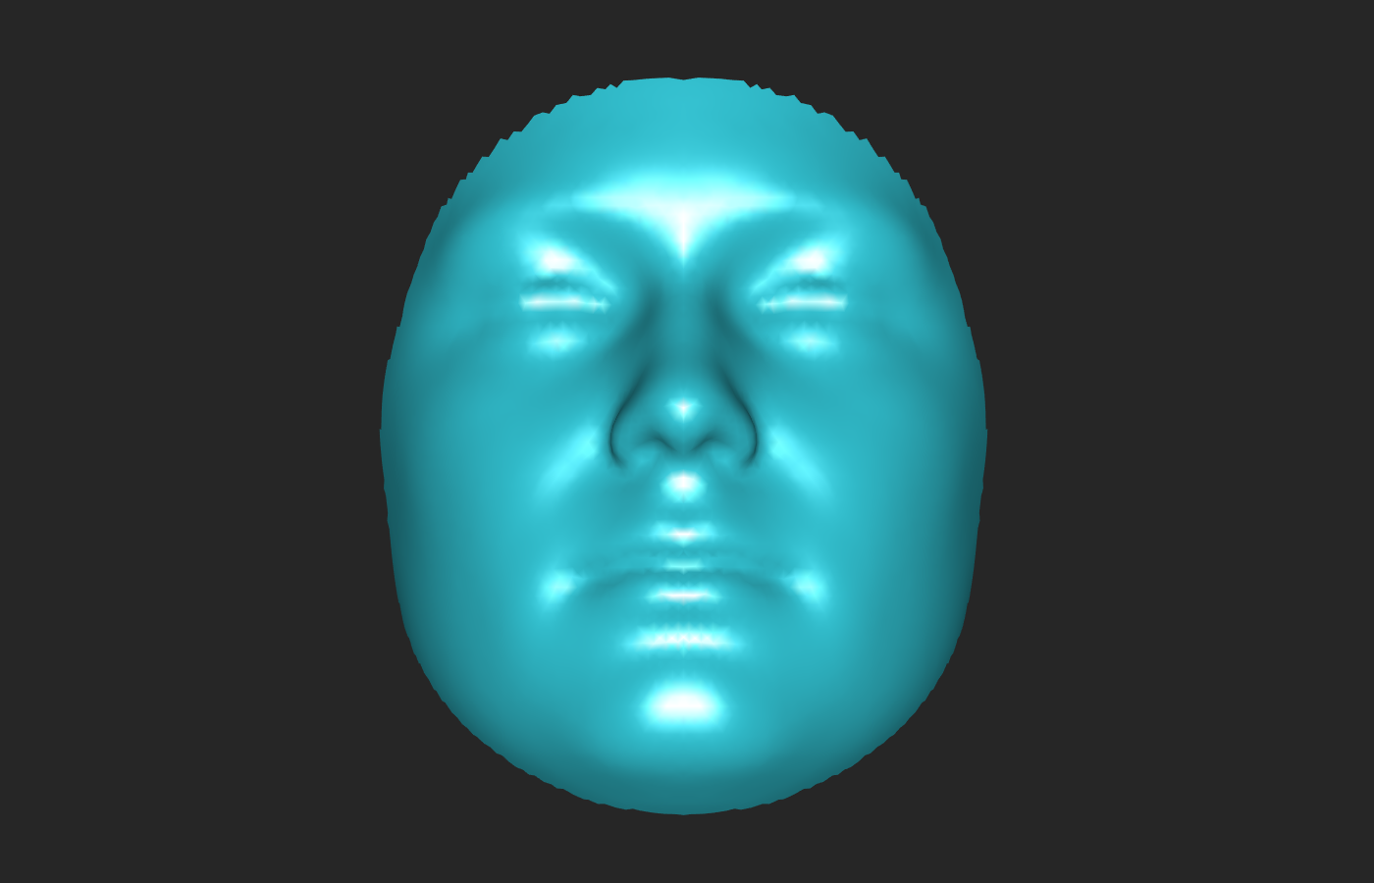
Exercise one

Slide 18
Exercise one:
Meshmonk makes use of point co-ordinates and ‘surface normals’. These are the directions perpendicular to the triangulated surface at each point and convey information about the local orientation of the surface.
Run the cell ‘Visualise the surface normals’

Slide 19
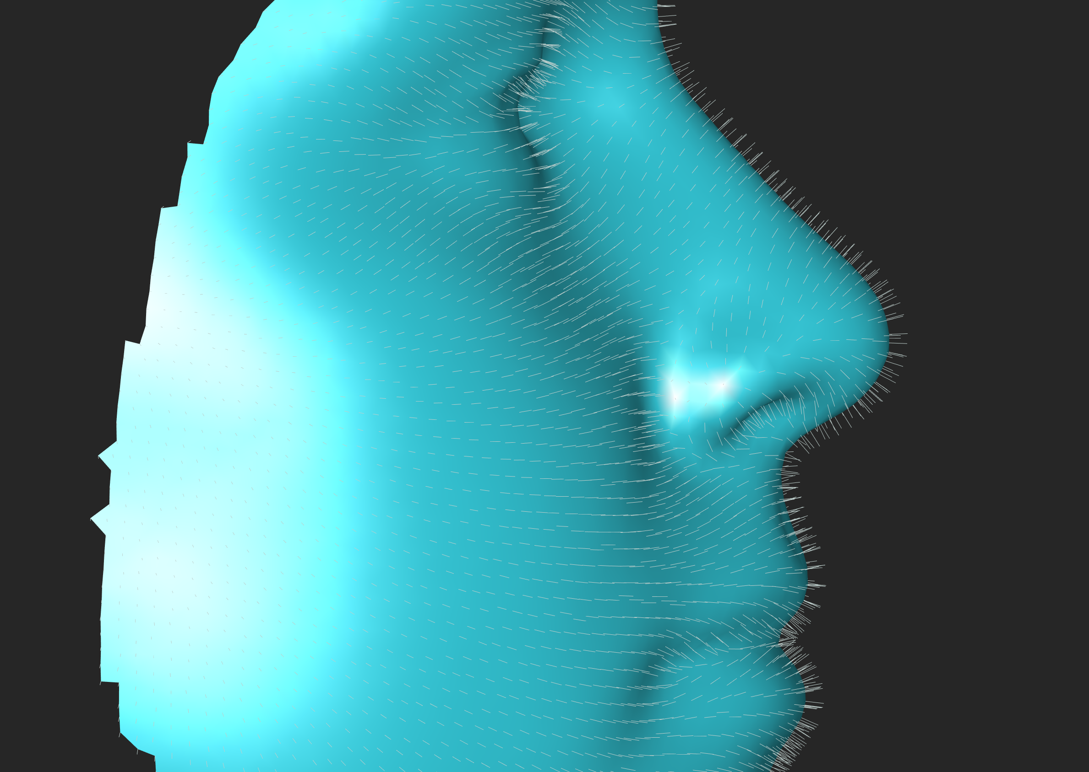
Exercise one:

Slide 20
Exercise Two: A single iteration of non-rigid ICP
Non-rigid mapping is accomplished iteratively. We will now explore what occurs in a single iteration. We will address how this changes in multiple iterations in the next exercise.
To illustrate this we use some of the core meshmonk functions ‘compute_correspondences’ and ‘compute_nonrigid_transformation’. In practice you will not need to use these directly. This will be explored more in exercise 3.

Slide 21
Exercise Two:
First we need an estimate how the points on the Floating image need to be deformed so as to be in the shape of the target.
Estimate corresponding points as the mean of the n ‘closest’ points.
Closeness is defined in terms of spatial proximity and similarity of surface normal.
Run the cells:
load Floating and Target Meshes
Step 1 - compute correspondences

Slide 22
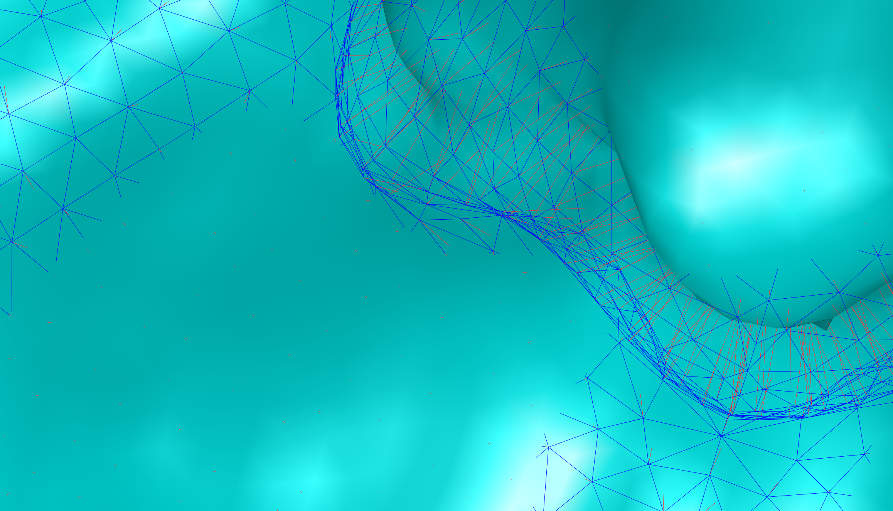
Exercise 2
It is a bit difficult to see, but in the window is plotted vectors (in red) from each point on the Floating face (blue wireframe) to its estimated corresponding points on the Target

Slide 23
Exercise 2
This provides an initial (but not particularly good) estimate of how the floating face should be deformed. To illustrate that it is not very good we will apply this deformation directly onto the Floating face and see what happens.
Run the cell:
See what happens if you apply the initial estimate directly

Slide 24
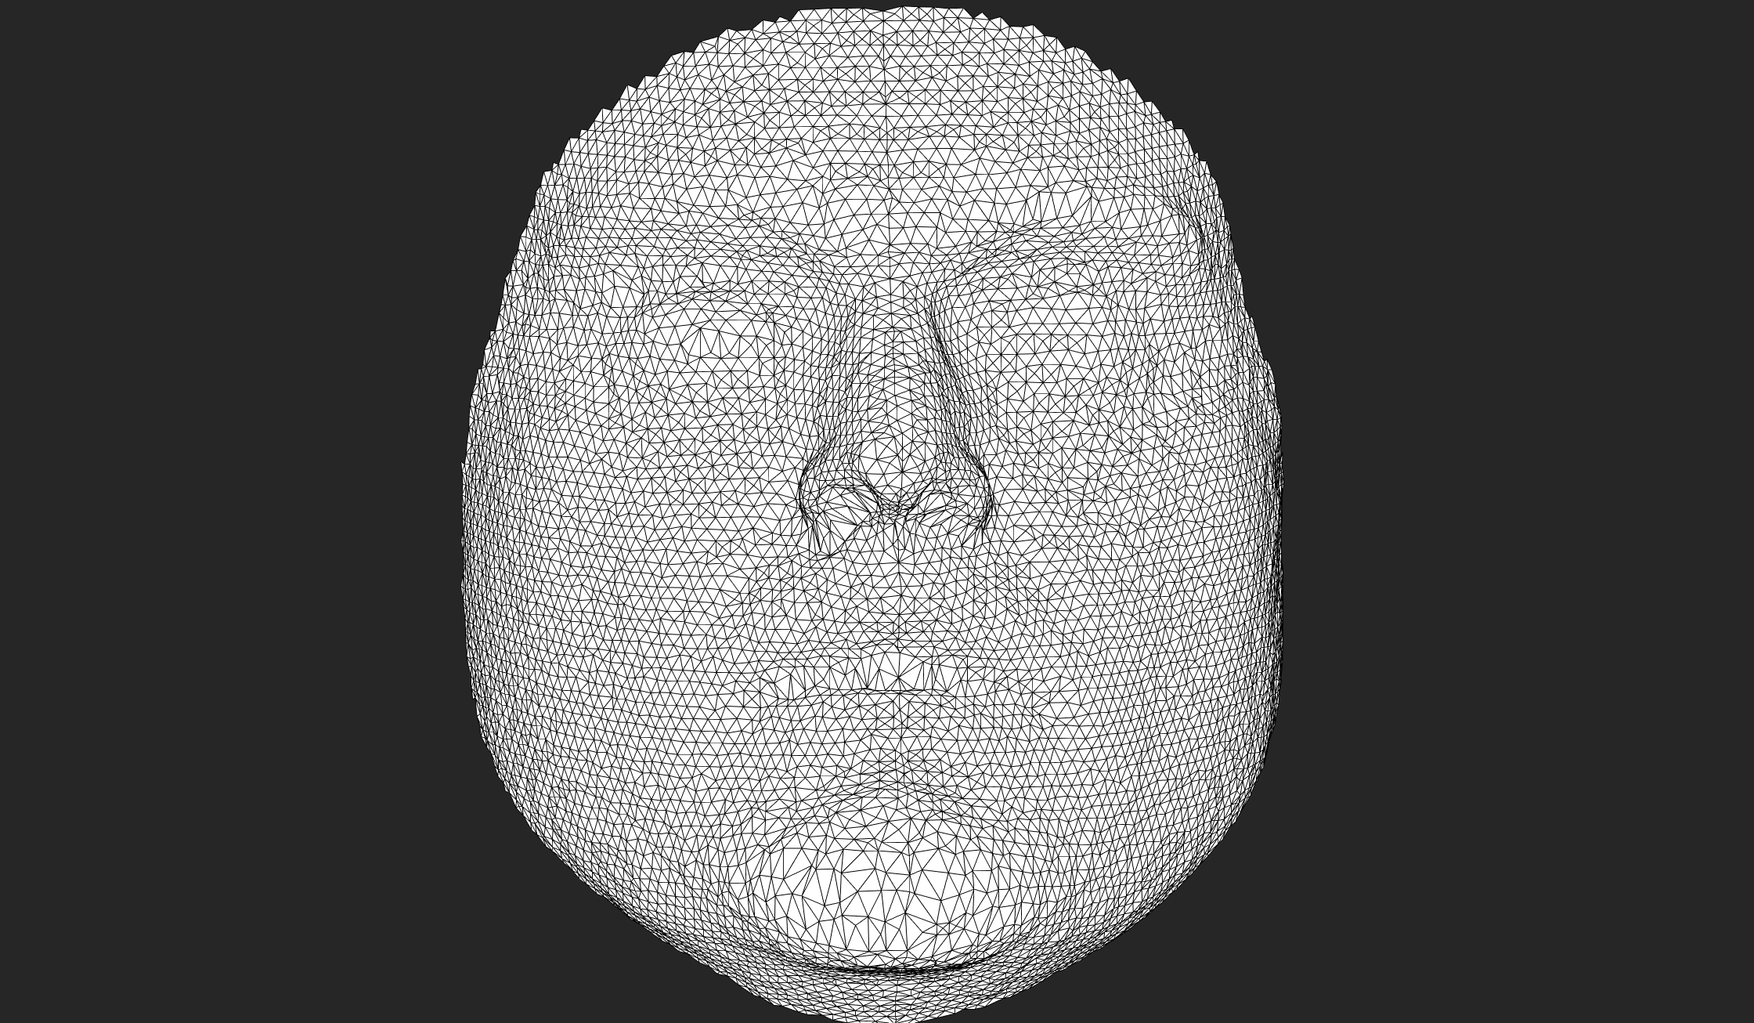
Exercise 2
Points of the Floating face that were initially regularly spaced are haphazardly displaced. Indicating the anatomical meaning is not likely to have been well preserved.

Slide 25
Exercise 2
So within each iteration of MeshMonk this initial deformation field is smoothed/regularized. This is accomplished by convolving the deformation field with a Gaussian ‘x’ number of times.
To complicate things a bit there are actually two types of smoothing applied. These are equivalent while we are only performing one iteration so we won’t talk about the difference yet.
This smoothing is implemented in the ‘compute_nonrigid_deformation’ function and is controlled primarily by two parameters which control how many times to convolve with the Gaussian (‘x’). These two parameters correspond to the two different kinds of smoothing.
numViscousIterations
numElasticIterations

Slide 26
Exercise 2
Play with the two regularization settings and run the cell:
Step 2 - Regularize deformation field.
E.g. try setting both parameters to 100, 10 and 1. and see how this affects how the deformation goes.

Slide 27
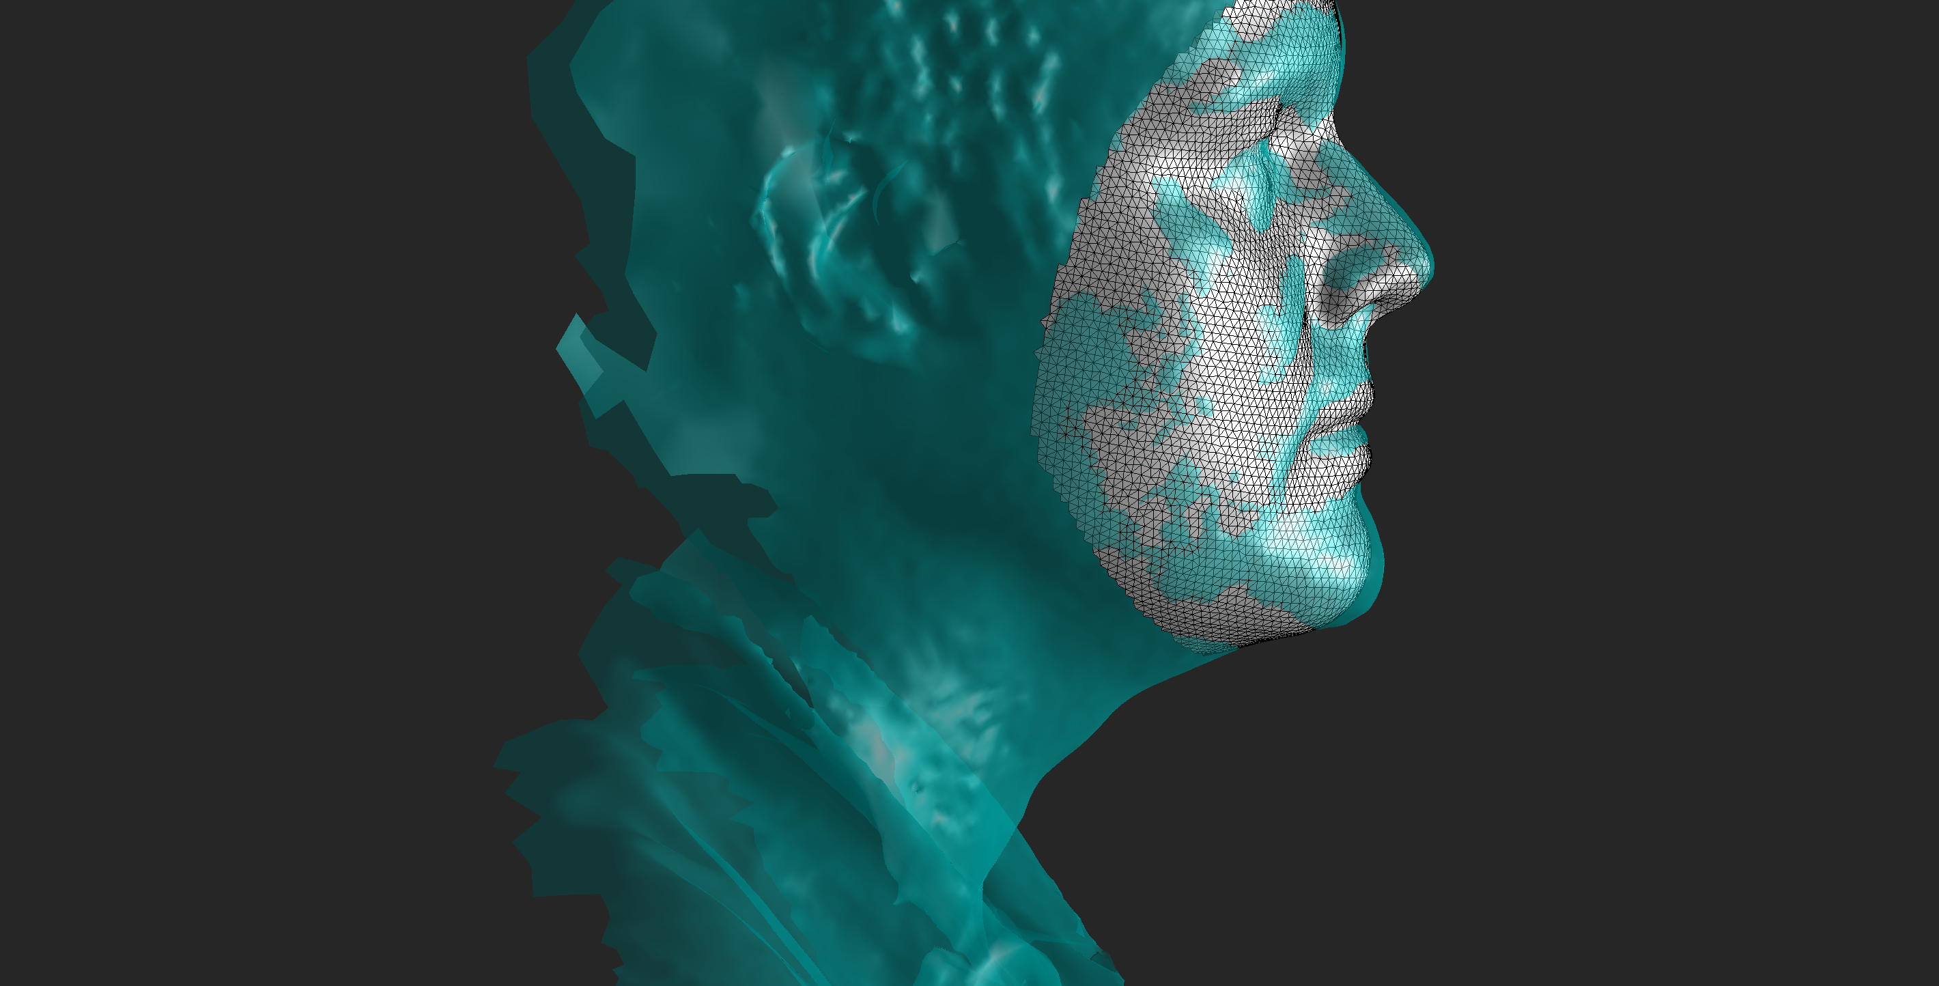
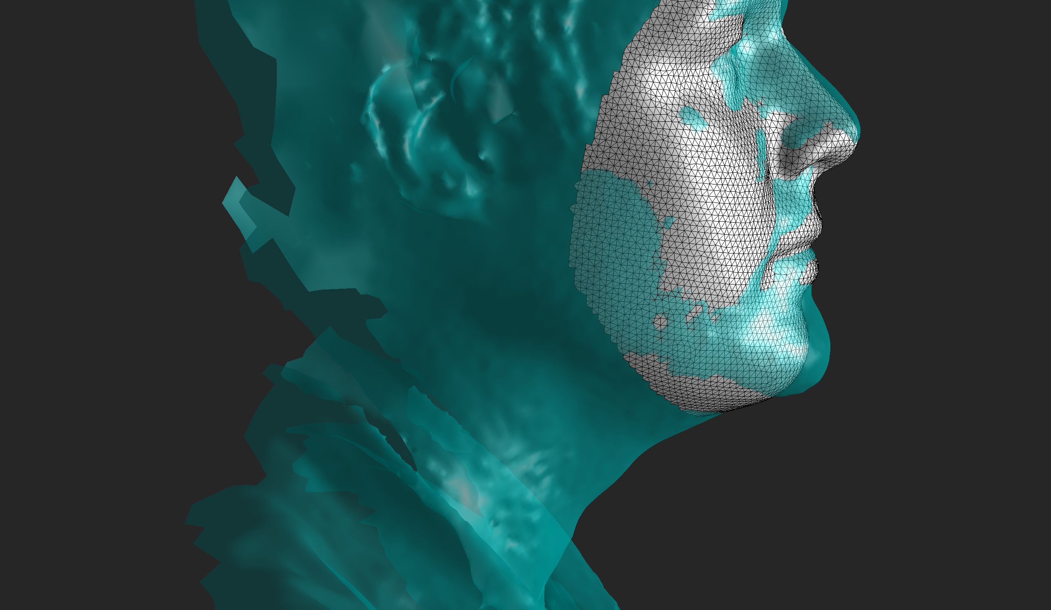
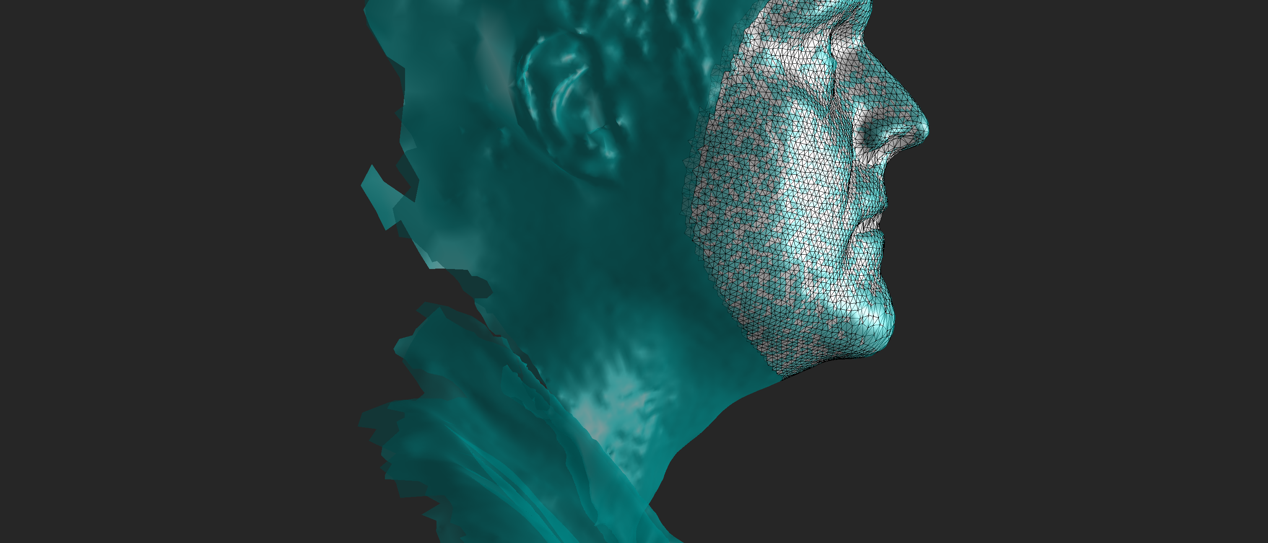
Exercise 2
100
5
0

Slide 28
Exercise 3: Deterministic Annealing
A single Iteration of meshmonk:
- Initial estimate of deformation (correspondences) -> Regularize deformation field x times and apply it to the floating mesh.
Too much regularization and the mesh will not match target, too little and the mesh deforms haphazardly (because correspondences are bad).
This impasse is overcome by the iterative framework. They key is to let the mesh deform gradually over multiple iterations. As the mesh gets closer to the target the correspondences get better and amount of regularization can be reduced, bringing the mesh yet closer to the target.

Slide 29
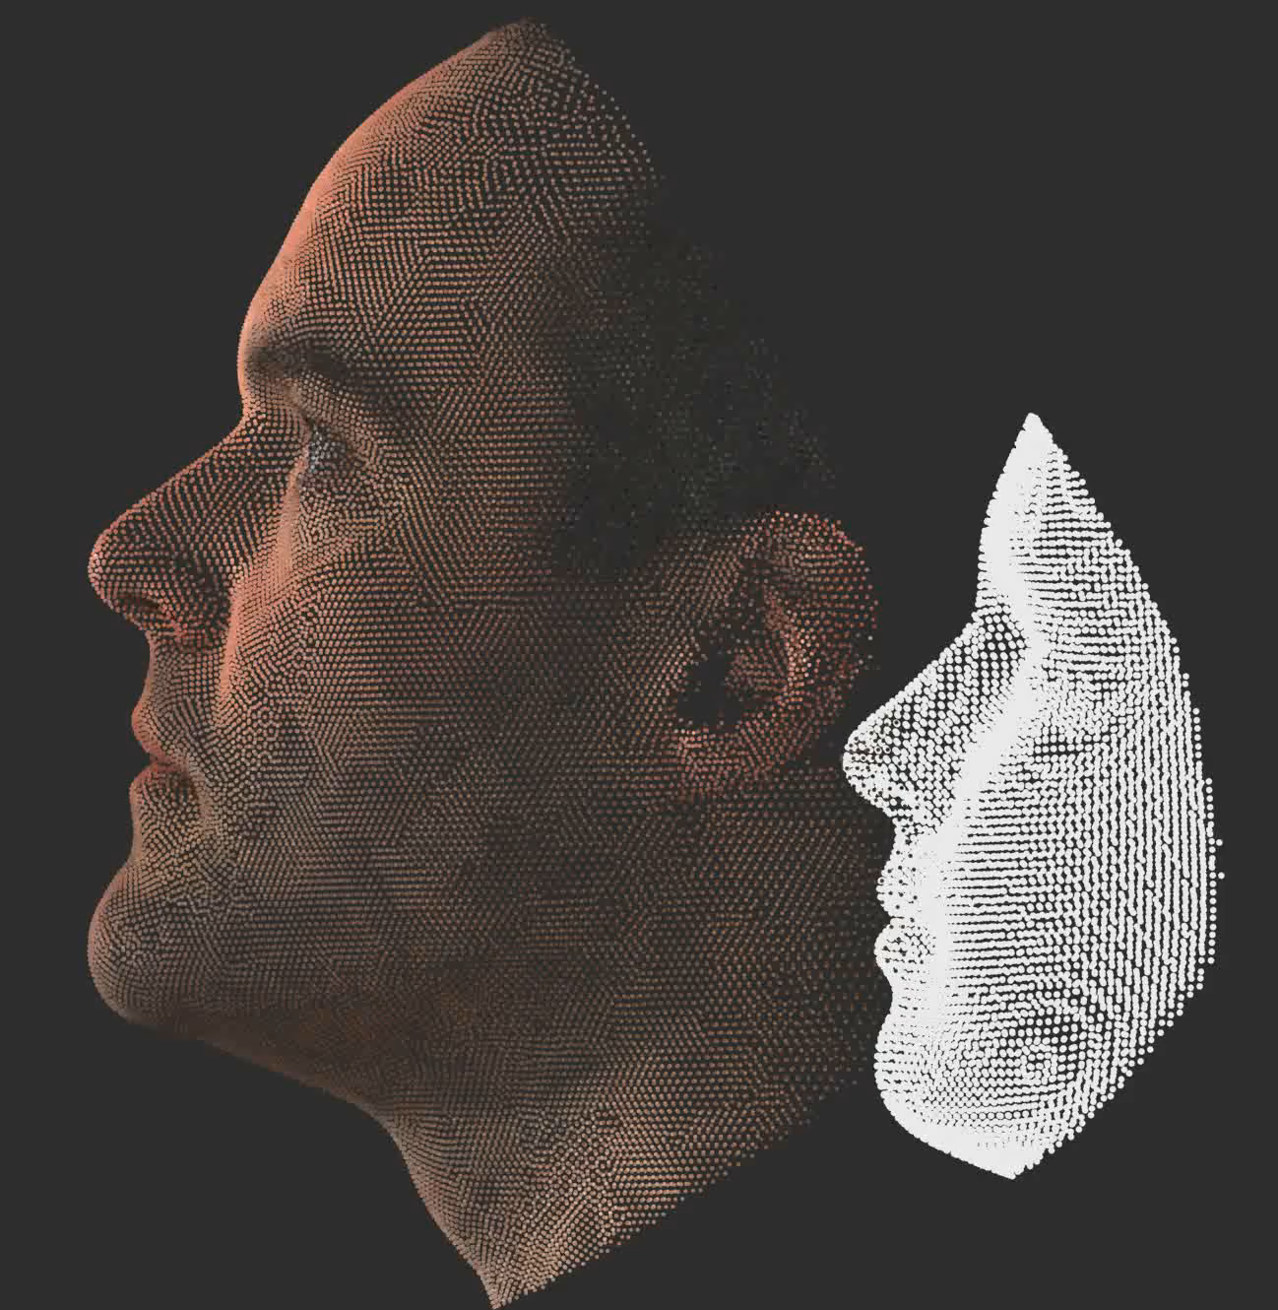
Exercise 3: Deterministic Annealing
Regularised deformation of template towards closest points
Reduce regularisation
Calculate ‘Closest’ points on target to template

Slide 30
Exercise 3: Deterministic Annealing
Regularised deformation of template towards closest points
Deterministic
Reduce regularisation
Calculate ‘Closest’ points on target to template

Slide 31
Exercise 3: Deterministic Annealing
Recall regularization in one iteration is controlled by
numViscousIterations
numSmoothingIterations
Within the iterative framework the value of these on any given iteration of the algorithm is a function of user-specified starting and ending values and the user-specified total number of iterations of the algorithm.

Slide 32
Exercise 3: Deterministic Annealing
Run the cell:
plot deterministic annealing
This calculates how the number of viscous smoothing iterations is reduced from 200 to 1 over successive iterations.
’numViscousIterationsStart’, ‘numViscousIterationsEnd’ and ‘numIterations’ and observe the effect on the plot.

Slide 33
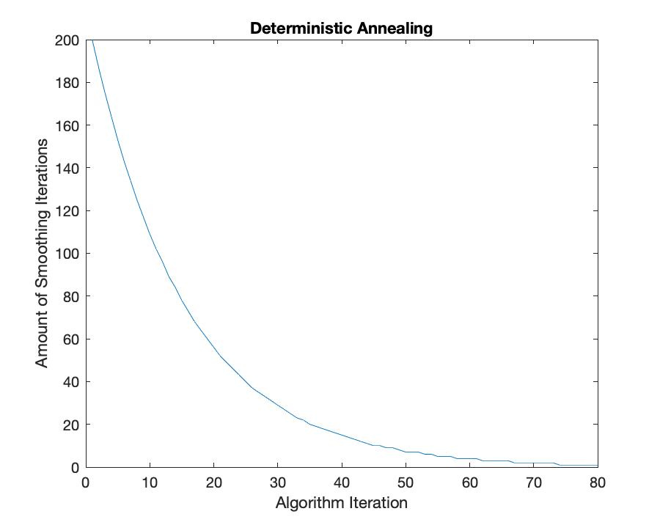
Exercise 3: Deterministic Annealing

Slide 34
Exercise 3:
Within the iterative framework there is a difference between Viscous and Elastic smoothing.
Viscous smoothing is applied to the deformation field from the deformed floating face output from the previous iteration.
Elastic smoothing is applied to the deformation field from the original position of the floating face at iteration 1.
So actually two deformation fields are estimated and combined.
In both cases the amount of regularization is reduced according to the same function ()

Slide 35
Exercise 4: Shape Mapper
The iterative framework implemented in the core MeshMonk functions is wrapped in the MATLAB ‘ShapeMapper’ class. This interfaces with the core meshmonk functions and controls the deterministic annealing.
We have already covered some of the most important settings. The final cell in the tutorial script creates a shape mapper and sets its settings. It is annotated with a brief description of what each one does. We won’t go into all of these but have a play yourself and watch the effect on the mapping. Try it out with your own data. See what happens.

Slide 36
Part Three: Tutorial – Batch processing images with MeshMonk

Slide 37
Preparing your images
We will not take you through this process in this tutorial, but we give some general information.
Images should be cropped and roughly landmarked. This is not supported (for all MATLAB versions) by the viewer class and the functionality will not necessarily be maintained so it is worth considering other options for how to do this.
Images can be cropped in MeshLab:
https://vimeo.com/98524579
Landmarking can be done in GeoMorph https://www.youtube.com/watch?v=4S8XcMMgUyw

Slide 38
Preparing your images
Get your meshes (in .obj format) and your landmarks in a some kind of delimited text file (e.g. .csv or .txt).
Arrange these in two separate folders (the script assumes they are called ‘Targets’ and ‘Landmarks’). For each Target image (e.g. Mesh1.obj) there must be a corresponding Landmark file (e.g. Mesh1.csv)
We provide a generic function for reading landmarks: readTextLandmarkFile that takes the following settings that can probably be adjusted to read any format that is essentially a delimited text file.
Filename,
file delimiter character,
column at which the landmark entries start
Column at which the landmark entries end
Row at which the landmark entries start
Row at which the landmark entries end

Slide 39
Practicalities
Open ‘BatchProcessingWithMeshmonk.m’

Slide 40
Cell 1: Set up paths
This tells MATLAB where to look for the Target image and landmark files and where to save the results.

Slide 41
Cell 2: Set up shape mappers
This cell constructs two ShapeMappers. One that will handle the Rigid ICP step, another that will handle the Non-Rigid ICP step.

Slide 42
Cell 3: Set up shape mappers
This cell constructs two ShapeMappers. One that will handle the Rigid ICP step, another that will handle the Non-Rigid ICP step.
This is determined by the ShapeMapper setting ‘TransformationType’

Slide 43
Cell 3: Batch Process Files
This cell addresses how to process files in batch.
First each Target file and landmark file is loaded
The landmarks on the target and floating face are used to estimate a first rigid alignment of the floating to the target.
There is a rough check of whether the normals of the floating and target both point inwards/outwards (if one set points inwards and one set points outwards this can cause many problems).
Executes Rigid ICP
Executes Non Rigid ICP
Saves the result.

